Slide 1





BrightInsights
for a Smarter Future

Slide 2




OUR TEAM
Ahsan
Zulfiqor
Anita
Manuel

Slide 3



PROBLEM STATEMENT
Urban traffic congestion is causing longer travel times, frustration, and more pollution in cities. Traditional traffic lights use fixed timing, which doesn’t adjust to changing traffic, leading to unnecessary delays and traffic jams. This lack of flexibility creates stress for drivers and contributes to wasted time and higher emissions
Notes:
Let's imagine, with me, a world where you are driving, you have the perfect music for the ride, and the windows are down, letting in the fresh air.
Everything seems perfect until... you hit a traffic jam. The red lights ahead stretch as far as the eye can see, and the minutes feel like hours.
Maybe you are late to your child presentation, or maybe just want to get home to rest.
You start to feel frustrated, your mood shifts, and you wish there was a better way to get you to your destination faster.
What if traffic could just... work with you?

Slide 4

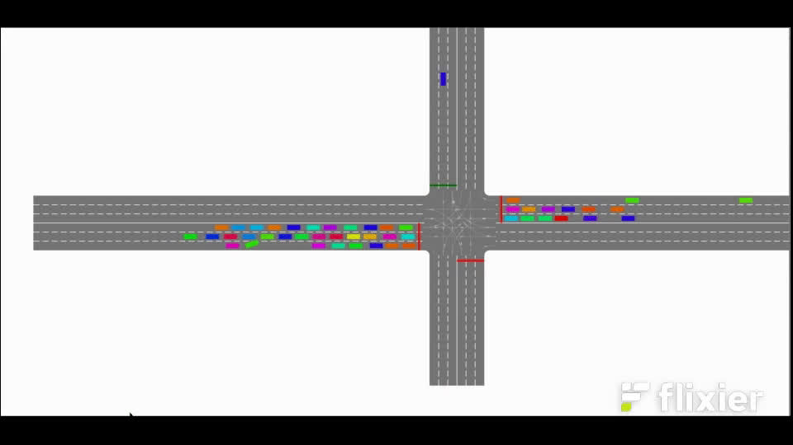
Notes:
Explain the simulation and how the actual traffic light system doesnt make smart decisions when it comes with roads without cars

Slide 5
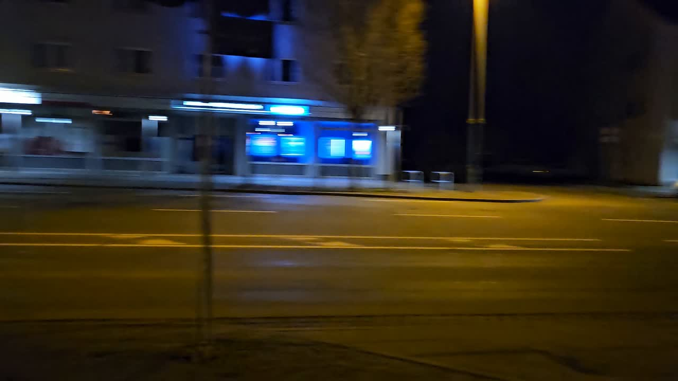

Slide 6

SOLUTION
AI decision
Our system will utilize AI and real-time sensor data to detect the number of approaching vehicles.
It will dynamically adjust green light duration based on actual demand, ensuring efficient traffic flow.
If no cars are detected, the system will immediately reallocate the green light where it's needed.
dynamic green
light adjustments
Additionally, we have created a Traffic Monitoring Dashboard that will aggregate real-time data from AI-driven traffic sensors to provide a comprehensive overview of traffic conditions
energy & fuel savings
Notes:
It will help decision-makers analyze congestion patterns, predict traffic build-ups, and offer data-driven insights for optimizing signal timing and urban planning.
Authorities can use this dashboard to make smarter, faster decisions that improve traffic flow, reduce emissions, and enhance road safety.

Slide 7
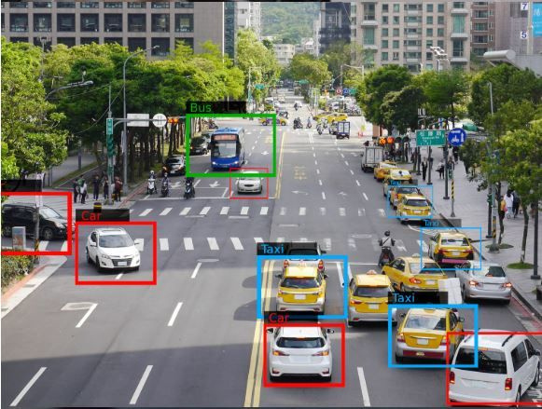
Vehicle Motion and Position Sensor using ML(Digital Image processing with Matlab, OpenCV)

Slide 8
IMPACT
Simulation results indicate that deploying smart traffic lights at a single intersection can reduce CO₂ emissions by 32% to 40% in the surrounding area. (1)
Waiting times at intersections were reduced by 53% to 95%, further cutting fuel consumption and emissions. (1)
(1) Santos, O., Ribeiro, F., Metrôlho, J., & Dionísio, R. (2024). Using smart traffic lights to reduce CO₂ emissions and improve traffic flow at intersections: Simulation of an intersection in a small Portuguese city. Applied Systems Innovation, 7(1), 3. https://doi.org/10.3390/asi7010003

Slide 9
16.49%
17.05%
CO₂ emissions
reduced
Increase in
Travel Speed
Wu, K., Ding, J., Lin, J. et al. Big-data empowered traffic signal control could reduce urban carbon emission. Nat Commun 16, 2013 (2025). https://doi.org/10.1038/s41467-025-56701-4

Slide 10

FUTURE PROSPECTS
Smart Mobility App
It will provide real-time traffic light updates to help drivers anticipate signal changes.
It will use AI-powered route optimization to suggest the most time- and fuel-efficient paths.
It will integrate with public transport to offer seamless multi-modal commuting.

Slide 11
THANK YOU
FOR YOUR ATTENTION

